Slide 1
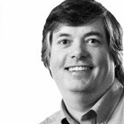

Huawei’s journey to Continuous Delivery
Anders Wallgren
CTO, Electric Cloud

Slide 2
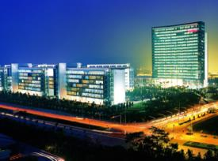

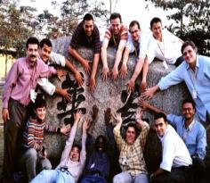
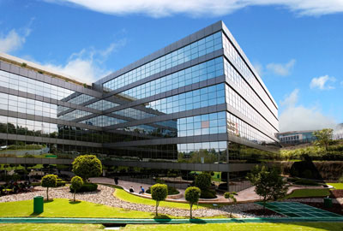

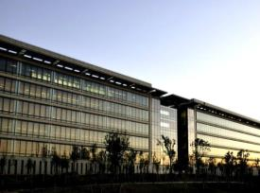
Who is Huawei?
A privately-owned Global Company
An Innovative Industry Contributor
An ICT Industry Leader
Notes:
A global company providing information and communications technology (ICT) solutions.
Products and solutions have been deployed in 140+ countries, serving 1/3 of the world’s population.
A privately-owned company founded in 1987, Shenzhen

Slide 3

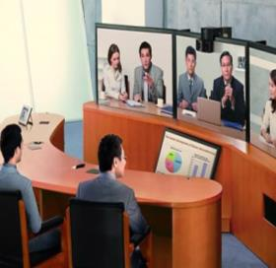

Who is Huawei?
Carrier
Business Group
Enterprise
Business Group
Consumer
Business Group
Revenue by business
Fixed Network
Wireless Network
Telecom Software and Core Network
Service
Enterprise Networking
UC&C
IT
SecoSpace
service
Devices
Devices Chipset
Devices Cloud
5%
Enterprise
73%
Carrier
(2012)

Slide 4


140+
Countries
16
R&D Centers
Revenue by Geo
14.5%
28
Joint Innovation Centers
14
Regional HQs
Americas
33.4%
China
17%
Asia Pacific
35.1%
70K
R&D Employees
45
Training Centers
150K
Employees Worldwide
EMEA
(2012)

Slide 5
41,948 patents in China
14,494 patents in ROW
12,453 international PCTs
USD$300 million/yr royalties
150+ standards organizations
30,000+ standards proposal
Accumulated R&D investments: USD 23 billion

Slide 6
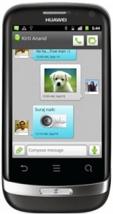
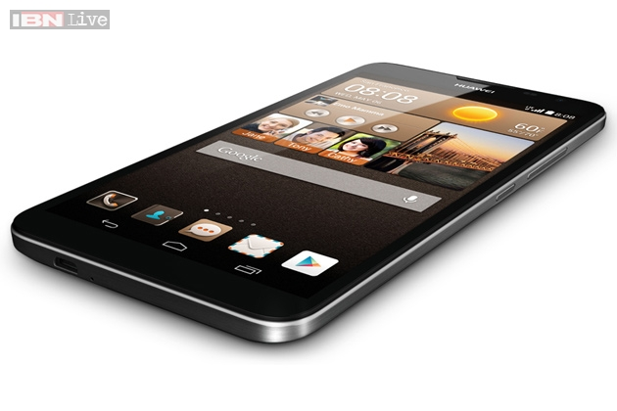
Makin’ it real
Huawei Phone - 2012
Huawei Phone - 2014

Slide 7
Previous State
DEV BUILD
10min
Per 5M LOC
PROD BUILD
300min
Per 10M LOC
Large scale R&D environment with complicated tools requires multi-thousands of CPU cores available on demand.
Environment/tools provisioning is very time-consuming; lab asset utilization is low.
FEATURE DELIVERY TIME
30days
REGRESSION TEST
240min
FULL TEST
1440min
Notes:
Shared “private cloud” resource for build and test and deploy
Multiple platforms from same virtualized environment

Slide 8

What next?

Slide 9

The Evalution
Premise 1:
Notes:
Ting evaluated a bunch of tools
Leaning towards open source to the extent possible

Slide 10
The Evaluation
Project Mgmt
JIRA
Redmine
Trac
Bugzilla
Provision
Monitor
SCM
Github
SourceForge
Chef
Nagios
GIT
Subversion
Mercurial
Puppet
Collaboration
Gerrit
Reviewboard
OpenGrok
CFEngine
Design
Development
Testing
Others
CI
Jenkins
Code analysis
Hadoop
Requirement
Analysis
Cpplint
CppCheck
Hive
HBase
PcLint
valgrind
Func Testing
Pef Testing
Unit Testing
Selenium
IOMeter
memcached
Design
modeling
Travis-CI
RabbitMQ
ActiveMQ
gUnit,cppUnit
Jmeter
Automation
Page Speed
Docker
gMock,JMock
Mobitest
Orchestration
Jenkins
RunDeck
ThoughtWorks Go
Electric Cloud
Cloud Platform
OpenStack
CloudStack
CloudFoundry
Notes:
PROBLEM: Couldn’t find OSS solution that fit the automation/orchestration need…
Electric Cloud is the ONLY commercial software in their CD orchestration stack everything else is OSS
Build up some common development and testing use cases
Realized they needed a better way to
Proved the concept

Slide 11

The implementation: CD-DevOps Solution
20
Rockstars
3
Months to V1
>1000
CD Pipelines on Commander/Day
Notes:
Don’t think 6 months is very fast at all…

Slide 12

“Asked for volunteers to try out the system.”

Slide 13

ALT How we convinced the first team to get on board

Slide 14
Where are we on our journey?
DEV BUILD
1min
Per 5M LOC
(was 10)
PROD BUILD
10min
Per 10M LOC
(was 300)
DEV BUILD
10min
Per 5M LOC
PROD BUILD
300min
Per 10M LOC
Bridging the gap between Dev and Ops
Multi-layer / multi-platform infrastructure
Devs gaining control over production environment
Concise definition and automation of processes
Globally distributed R&D teams
FEATURE DELIVERY TIME
7days
(was 30 days)
REGRESSION TEST
240min
FULL TEST
360min
(was 1440)
FEATURE DELIVERY TIME
30days
REGRESSION TEST
60min
(was 240)
FULL TEST
1440min
Notes:
Shared “private cloud” resource for build and test and deploy
Multiple platforms from same virtualized environment
What does “adoption” look like per team?
Combined solution: ElectricCommander, Rally, JIRA and many internal tools
1st product onboarded in March
10 products deployed, 2 in-progress
2014 goal: 20 products
2015 goal: 40 products
Overall goal: all products
100-1000 engineers/product
>300-500 pipelines/product/day
10-100 agents per product
What are the benefits?
Compressed cycle times
More frequent product releases
Quality is better – more cycles, more testing
Quality feedback time shorter
More visibility – manager can see all his programs over time, where there are problems (Red), prevent problems before they happen
Find problems before the customer does

Slide 15
What’s “faster?”
Design
Develop
Product Validation
Solution Validation
Days to Hours
Architect Evaluation
Hours to Minutes
Code Analysis
Weeks to Days
Full Functional Testing
Months to Weeks
Solution Testing
Hours to Minutes
Compile and Build
Days to Hours
Full Regression (System)
Days to Hours
Hardware Emulation
Days to Minutes
Full Regression (Software)
Notes:
What does “adoption” look like per team?
Combined solution: ElectricCommander, Rally, JIRA and many internal tools
1st product onboarded in March
10 products deployed, 2 in-progress
2014 goal: 20 products
2015 goal: 40 products
Overall goal: all products
100-1000 engineers/product
>300-500 pipelines/product/day
10-100 agents per product
What are the benefits?
Compressed cycle times
More frequent product releases
Quality is better – more cycles, more testing
Quality feedback time shorter
More visibility – manager can see all his programs over time, where there are problems (Red), prevent problems before they happen
Find problems before the customer does

Slide 16

10K+
Releases/year
>1M
System Integrations/year
100K
Builds/day
30M
Lines of Code
100M
Test cases run/day
480K
Code reviews/year

Slide 17

Now… Who else wants some?
Notes:
10 teams waiting for

Slide 18
Thanks
Questions?

